Slide 1
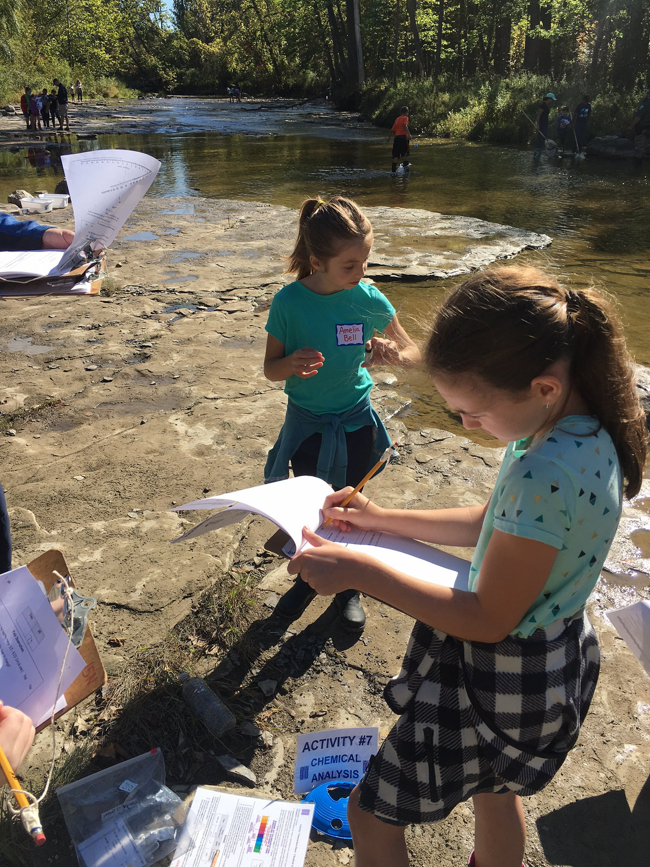
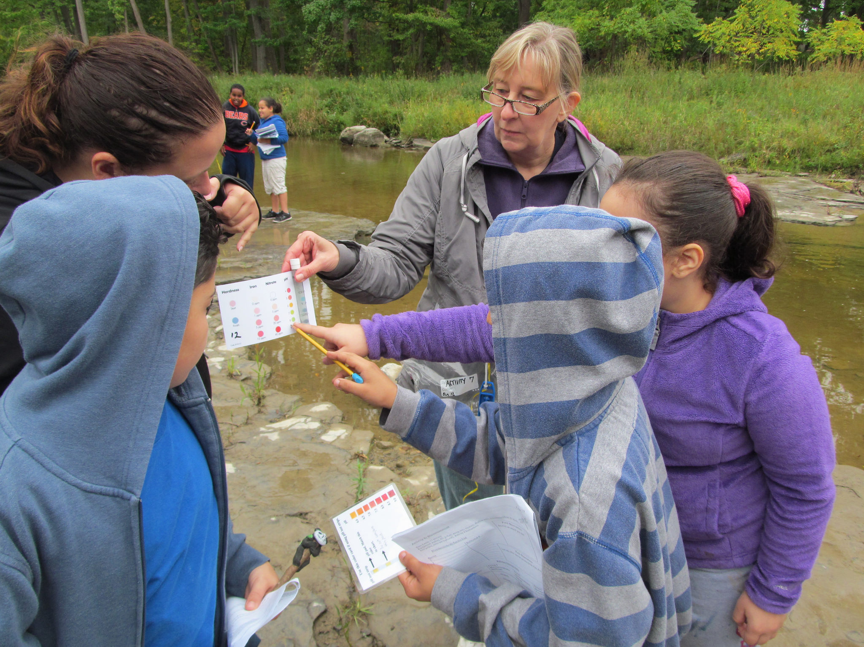
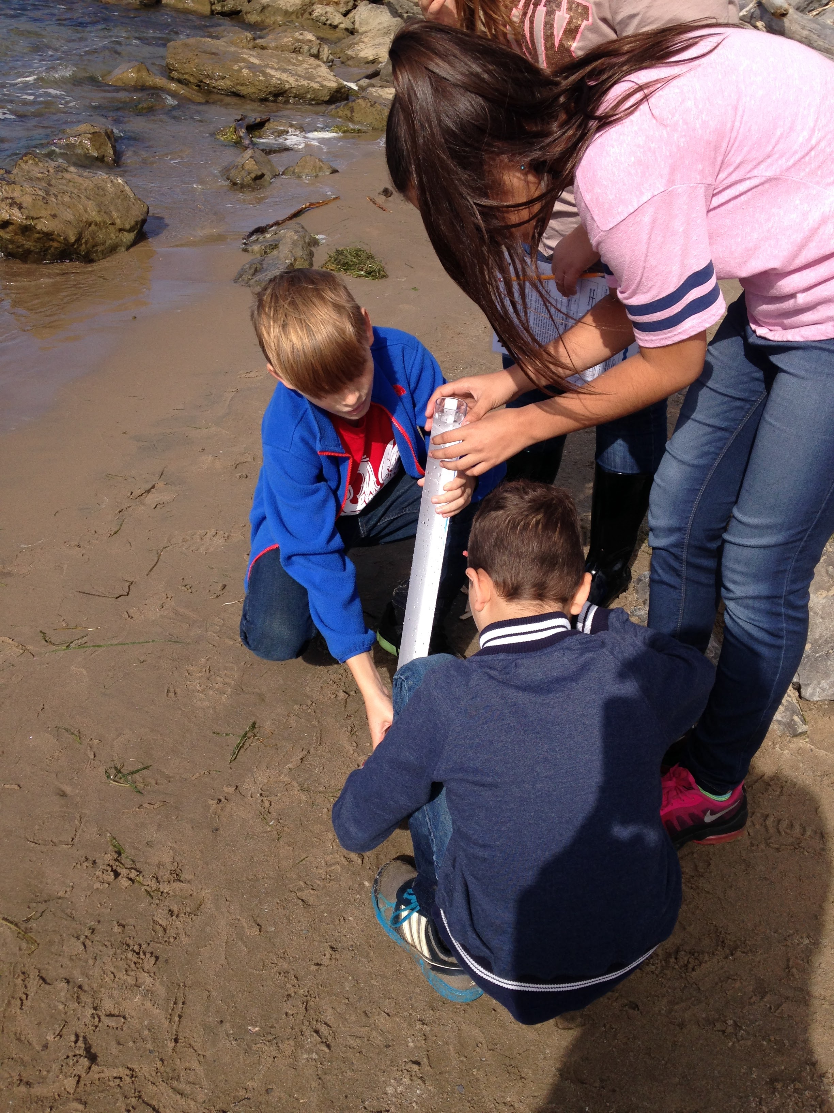
Field Trip!

Slide 2
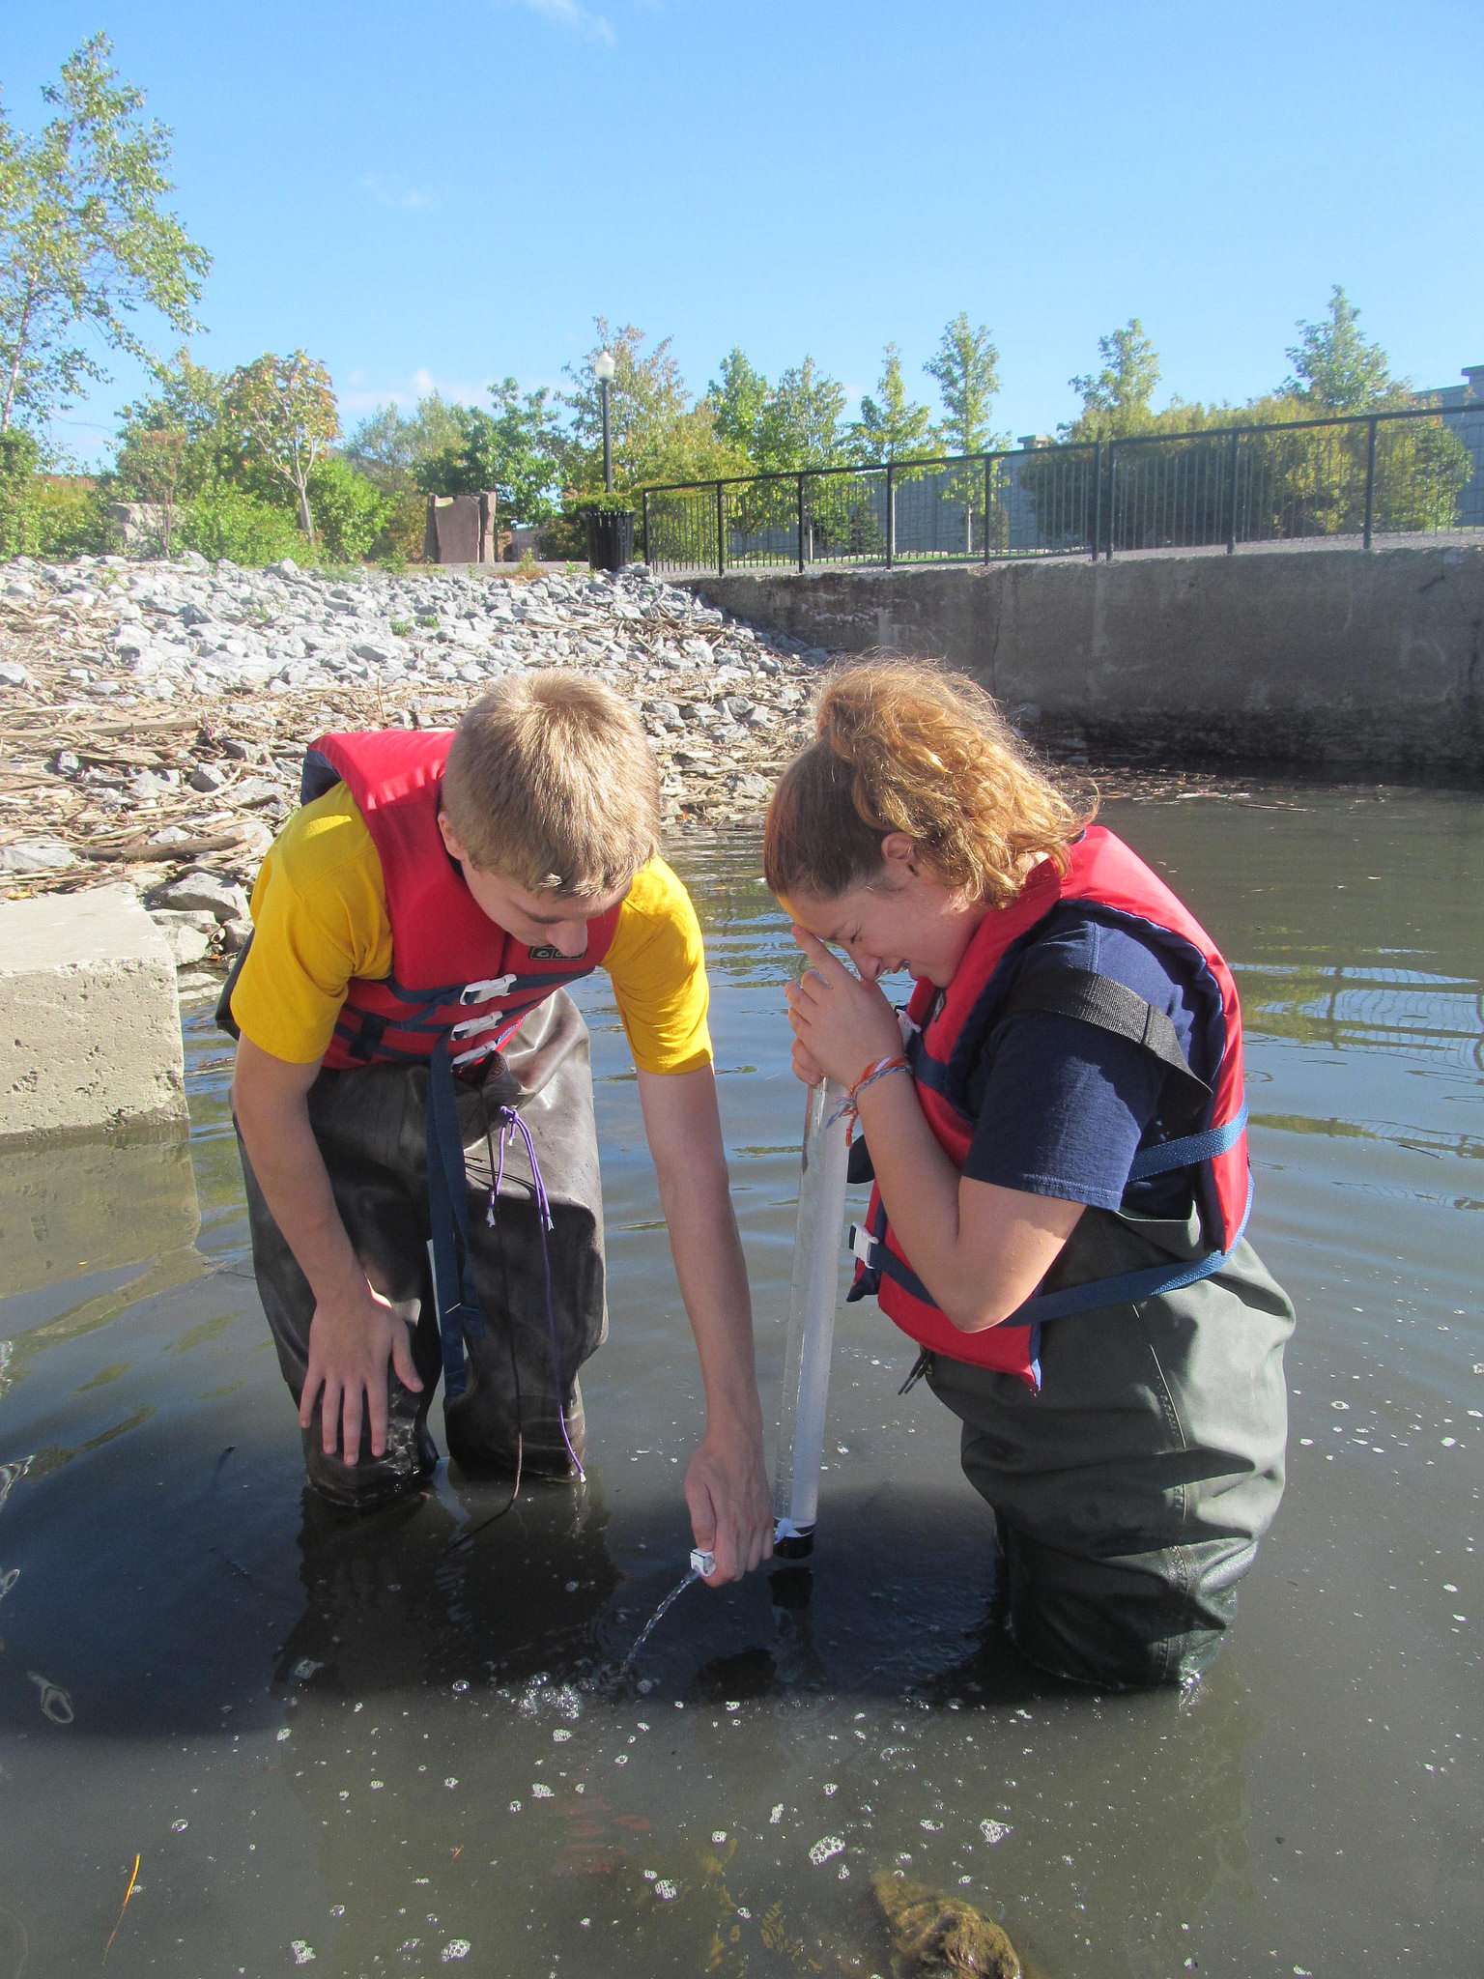
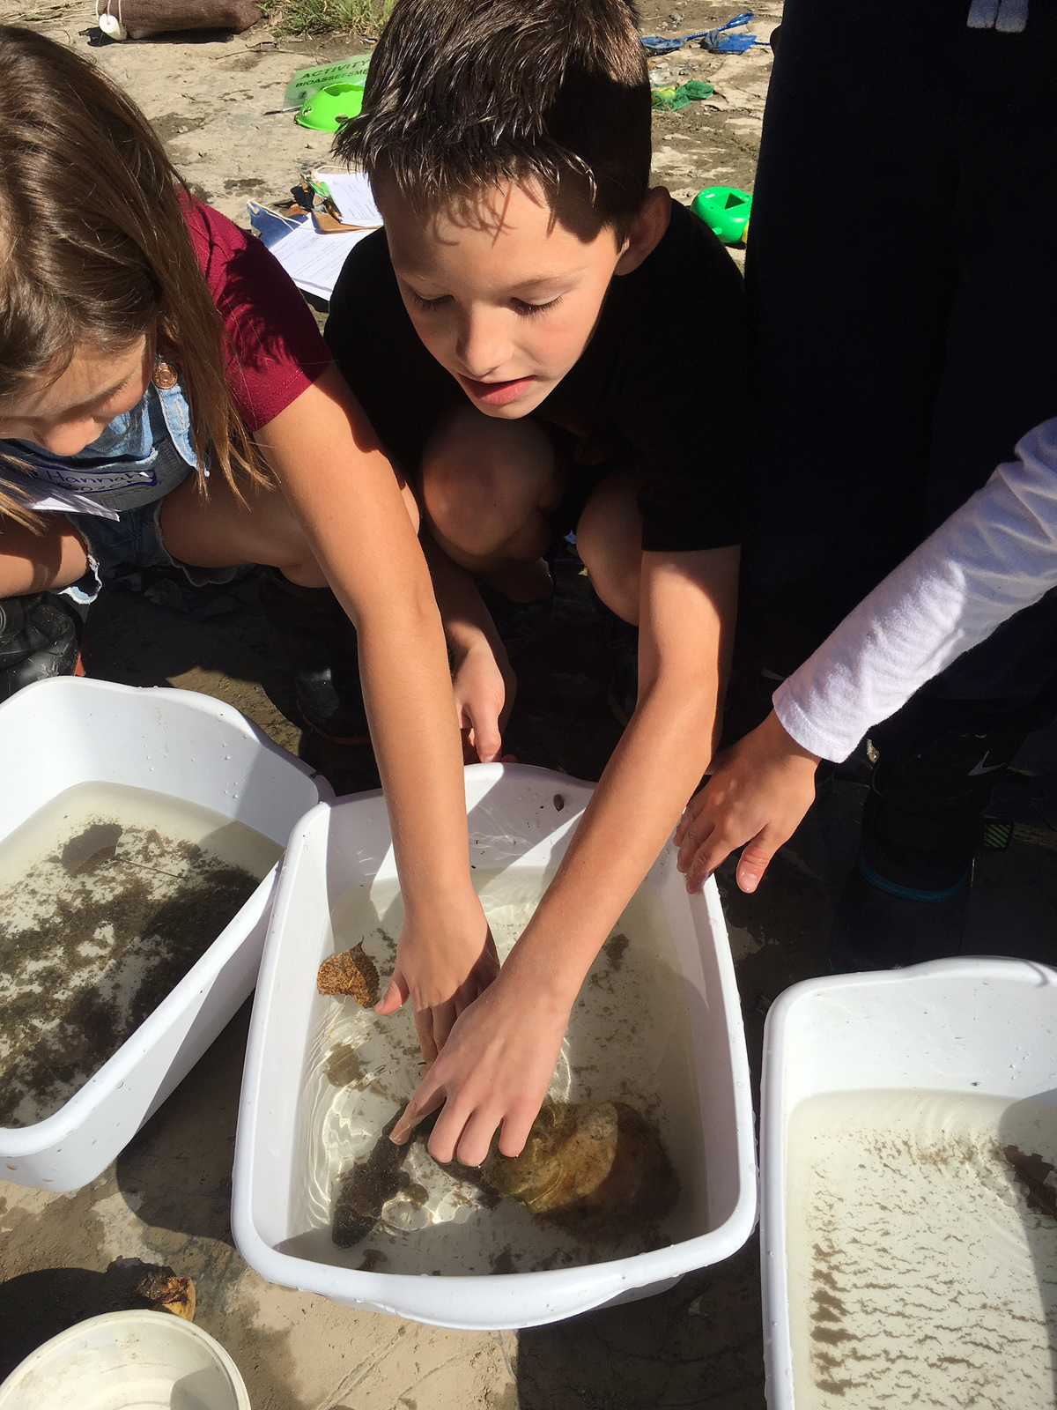
What is “A Day in the Life”?
“A Day in the Life” is all about hands-on discovery!
You will explore a unique site along the river and collect data to create a complete “picture” of the river.
Your data is then shared online so you can compare your data with data from other schools.
There are four main parts of the Buffalo River event:
The Historical River: how the river’s past influences its present.
The Physical River: temperature, weather, wind and environment at the site.
The Zoological River: collect and identify animals to determine water quality.
The Chemical River:: measure pH and dissolved oxygen levels.
Notes:
A watershed is an area of land where all living things and linked by a common water source.

Slide 3
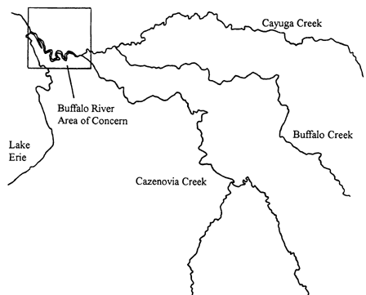
Buffalo River
Buffalo River
The Buffalo River flows into Lake Erie.
Three tributaries join together to form the Buffalo River:
Cayuga Creek
Buffalo Creek
Cazenovia Creek
Notes:
3 tributaries: Cayuga, Buffalo, Cazenovia
Join together at various points to form Buffalo River (8.7 miles long)

Slide 4
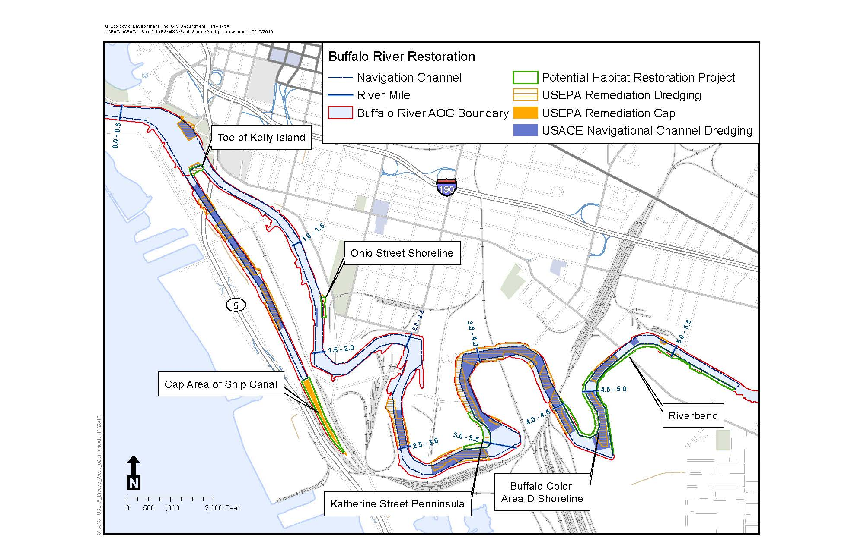
Brief History
Area of Concern/Buffalo River Restoration
1900s: Buffalo experiences huge industrial and economic growth along the waterfront. Industries dump toxic chemicals into the river.
1965: Buffalo River declared functionally dead and “devoid of life.”
1987: Buffalo River named an “Area of Concern” by the Environmental Protection Agency due to its severe environmental degradation.
2011: The Buffalo River Restoration Partnership begins major restoration efforts.
2019: The Buffalo River is no longer an Area of Concern (???)
Map: Ecology & Environment
Notes:
Please see “Buffalo River Watershed/Historic Industries/River & Tributaries, “DITLBR Sample Sites”
“Event Overview – Historical Timeline/10 Cool Facts” for more information.
Also, Teacher Packet: “A Brief Look at the Buffalo River.”

Slide 5
Event Information Teacher Packet page 1
Warning: you are guaranteed to get wet and muddy!
Dress appropriately.
Bring extra shoes or rubber boots.
Wear clothes that can get muddy.
Program should last between 2-3 hours.
Your school is partnered with a local environmental organization – your own on-site “River Expert.”
You will be working in groups of 3-6 students. Groups will rotate through activities in order.
There are 7 activities. You will have 15 minutes to complete each activity. Record your data in your Student Activity Packet.

Slide 6
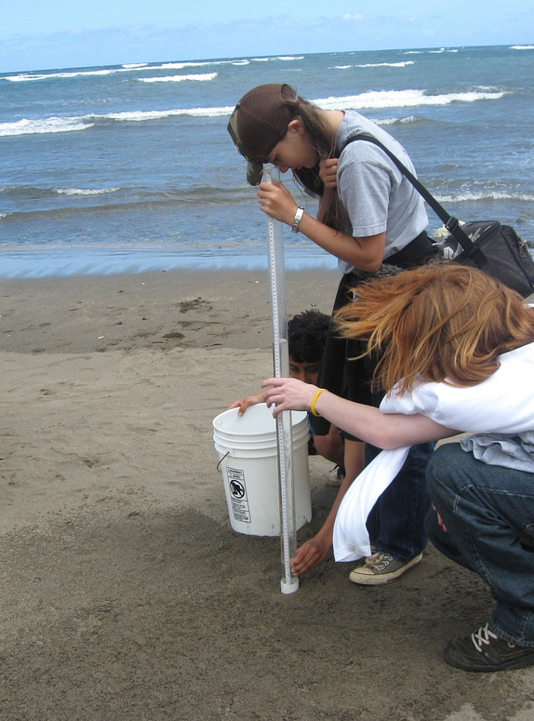
#1: Turbidity
How turbid is
the water?
Turbidity = the cloudiness of water.
Turbidity is caused by small plants, animals, sand, mud, and pollutants suspended in the water.
You will gather a sample of river water and use a special “turbidity” tube to measure the cloudiness of the water.
Equipment:
Turbidity tube
Measuring cup
Waders
Life jacket
How could cloudy water
affect the plants and animals that live in the river?

Slide 7
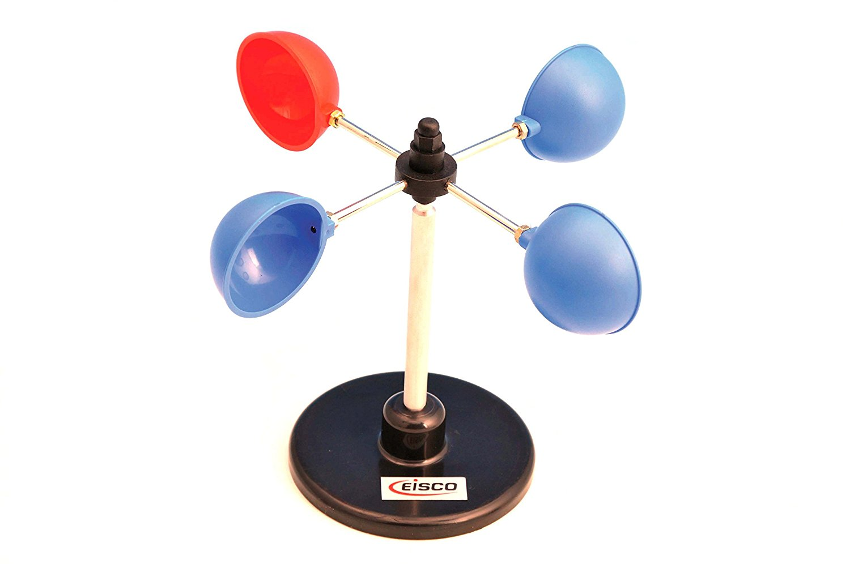
#2: Weather and Wind
You will measure air temperature, observe current weather conditions, and determine how recent weather conditions could affect their data
How do weather and wind affect water quality?
How could recent weather conditions affect water quality?
Equipment:
Air thermometer
Compass
✪ Anemometer (New 2018)

Slide 8
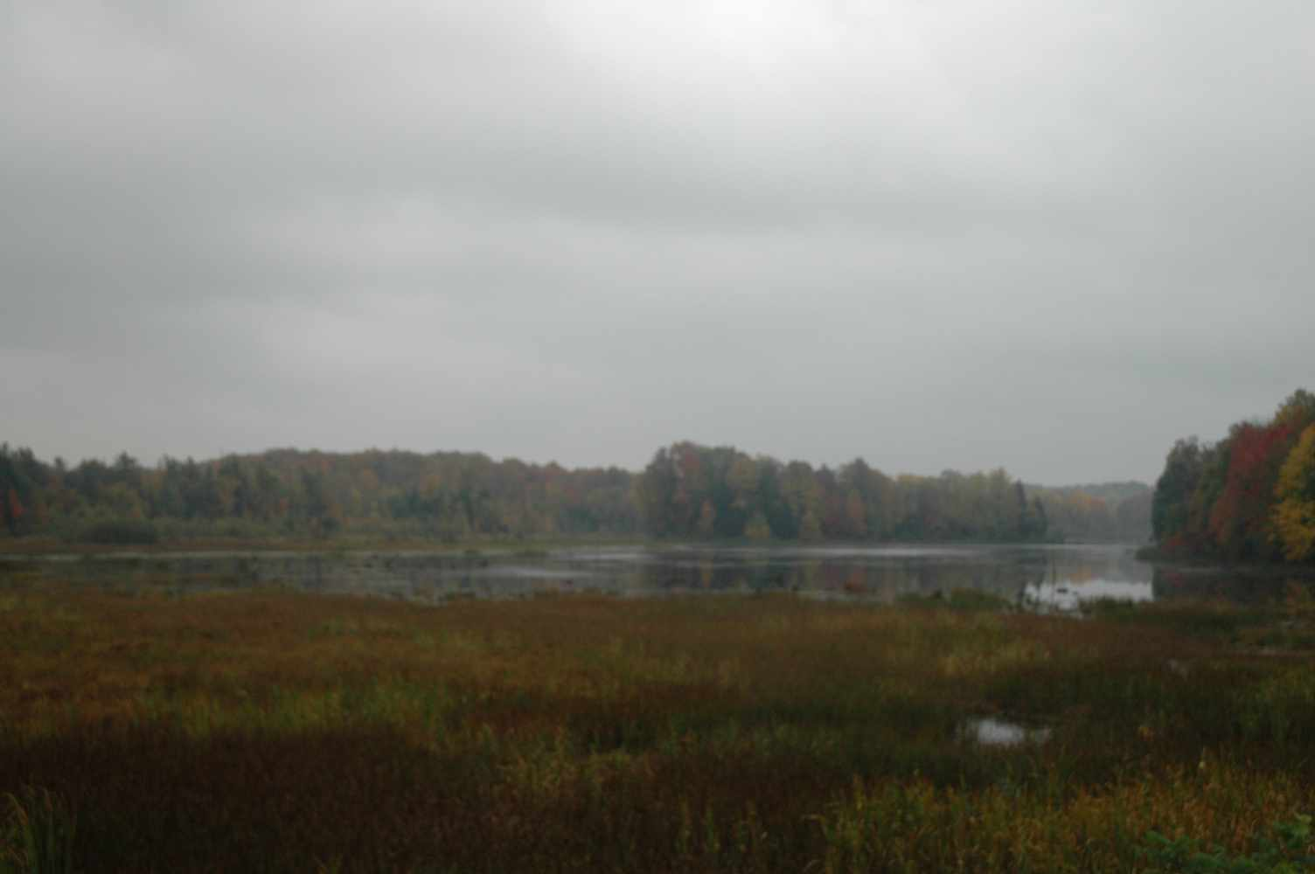
#3: Environment at the Sampling Site
How is each sample site unique?
You will investigate and describe the make-up of the surrounding environment and how the land use potentially affects the river.
What does the river habitat look like?
How is the site used by people?
What does the shoreline look like?
What does the river water look like?
Equipment:
Measuring tape/stick
Waders
Life jacket
Field guides (optional)

Slide 9
#4: Water Chemistry Nitrate & Phosphate (New 2018)
You will measure nitrate and phosphate levels by dissolving tablets or test strips in a water sample and matching the sample color to the chart.
How much nitrogen and phosphorus are in the water?
Equipment:
Water chemistry kit
Waders
Container for waste chemicals
What may happen if there
are high levels of nutrients
in the water?

Slide 10
#5: Water Temperature
You will measure water
temperature, record depth
of sampling, and identify sources
of thermal pollution at the site.
What temperature is the water?
How does temperature affect water quality?
Cold water holds more oxygen than warm water.
Water temperature can affect feeding, spawning, and migration of fish.
Does water temperature affect the plants
and animals living in the river?
Equipment:
Water thermometer
Meter stick
Waders

Slide 11
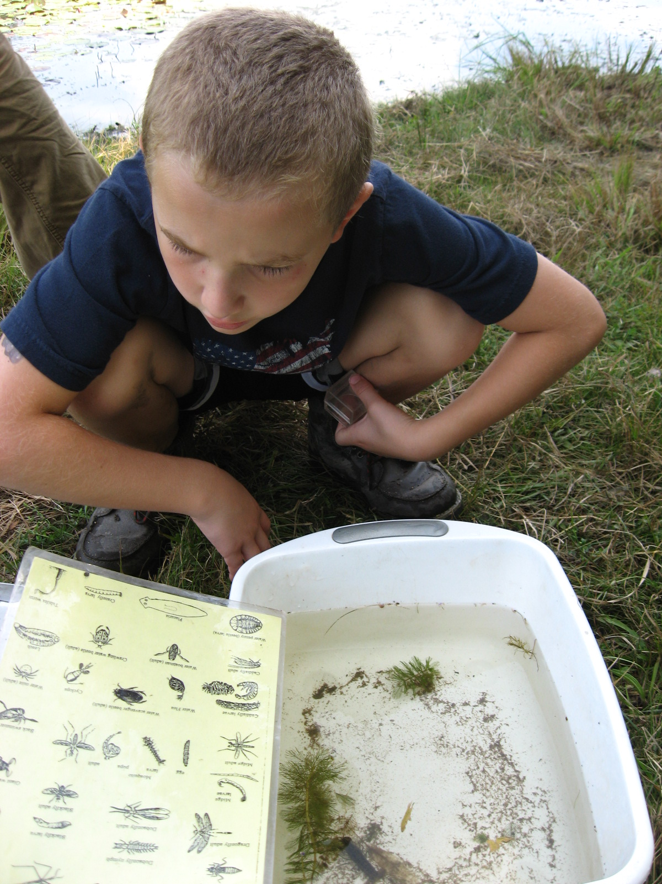
#6: Bioassessment
Get ready to get wet! You will
scoop for macroinvertebrates/ aquatic animals, identify and record each species, and score their water quality based on their results.
Macroinvertebrate: animal without a backbone and is visible to the naked eye
Pollution Tolerance Index
Bioassessment: an inventory of living things that helps determine water quality.
Pollution tolerant vs. intolerant species: some macroinvertebrates are more sensitive to pollution than others.
What lives in the river, and what can that tell us about water quality?
Equipment:
Waders
Life jacket
Scoop nets
Viewers
Containers, shallow tubs
Macroinvertebrate ID
Seine net

Slide 12
#7: Water Chemistry - Dissolved Oxygen (DO)
You will measure DO levels by dissolving tablets in a water sample and matching the sample color to the DO chart.
A healthy stream DO range is 5 – 11 ppm.
Photosynthesis and windy conditions ADD oxygen to water.
Decomposition, respiration, and pollution SUBTRACT oxygen from water.
How much oxygen is in the water?
Equipment:
Water chemistry kit
Waders
Water thermometer
Container for waste chemicals
Are the dissolved oxygen levels at your site healthy?

Slide 13
#7: Water Chemistry - pH
You will measure pH levels by dissolving tablets or test strips in a water sample and matching the sample color to the pH chart.
How acidic or basic is the water?
Is it suitable for life?
Equipment:
Water chemistry kit
Waders
Container for waste chemicals
A healthy stream pH range is 6.5 – 8.2.
Many organisms are very sensitive to pH changes.
Is the pH level suitable for life?

Slide 14
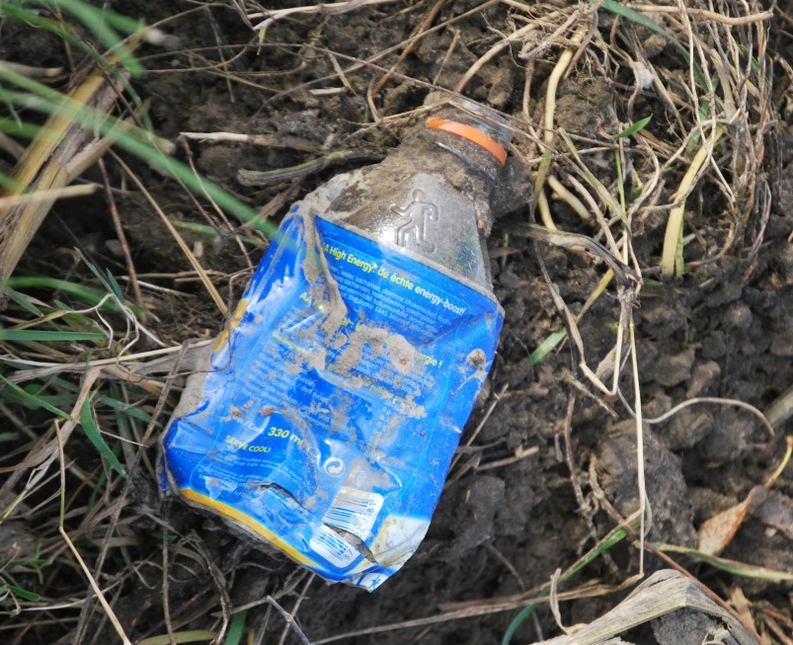
Clean Your Watershed!
After the rotations, you will have a few minutes to to pick up trash at the sampling site, leaving the location in a better condition than when you arrived!
How does litter relate to water quality and the health of the ecosystem?
Notes:
Expertise: Great lakes Issues, invasive species, history, pollution, restoration efforts, flora & fauna, water chemistry, etc.

Slide 15
End of Event
Students help collect and clean equipment and return it to the bin.
Ensure sample site and its facilities are left in good order.
Have students share something they learned/a way to protect the river.
The tarp is a great place to collect equipment.

Slide 16
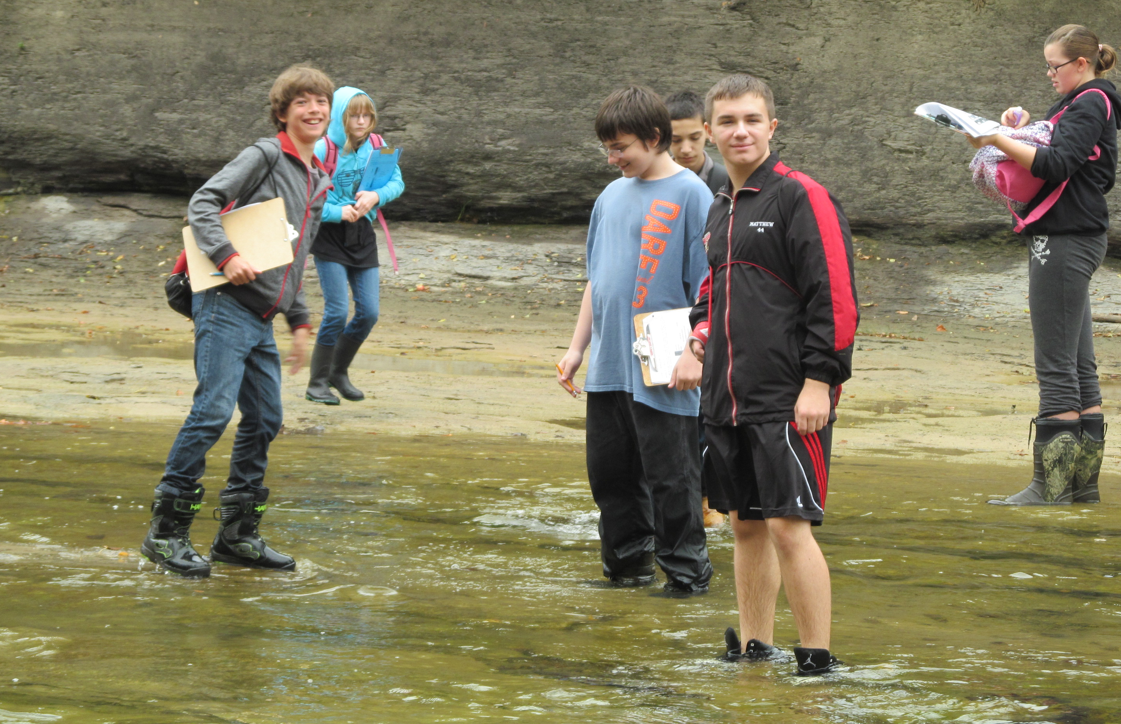
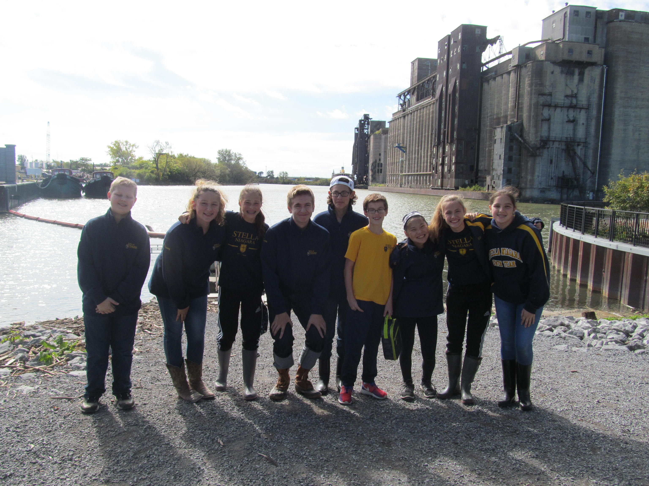
HAVE FUN!

