Slide 1
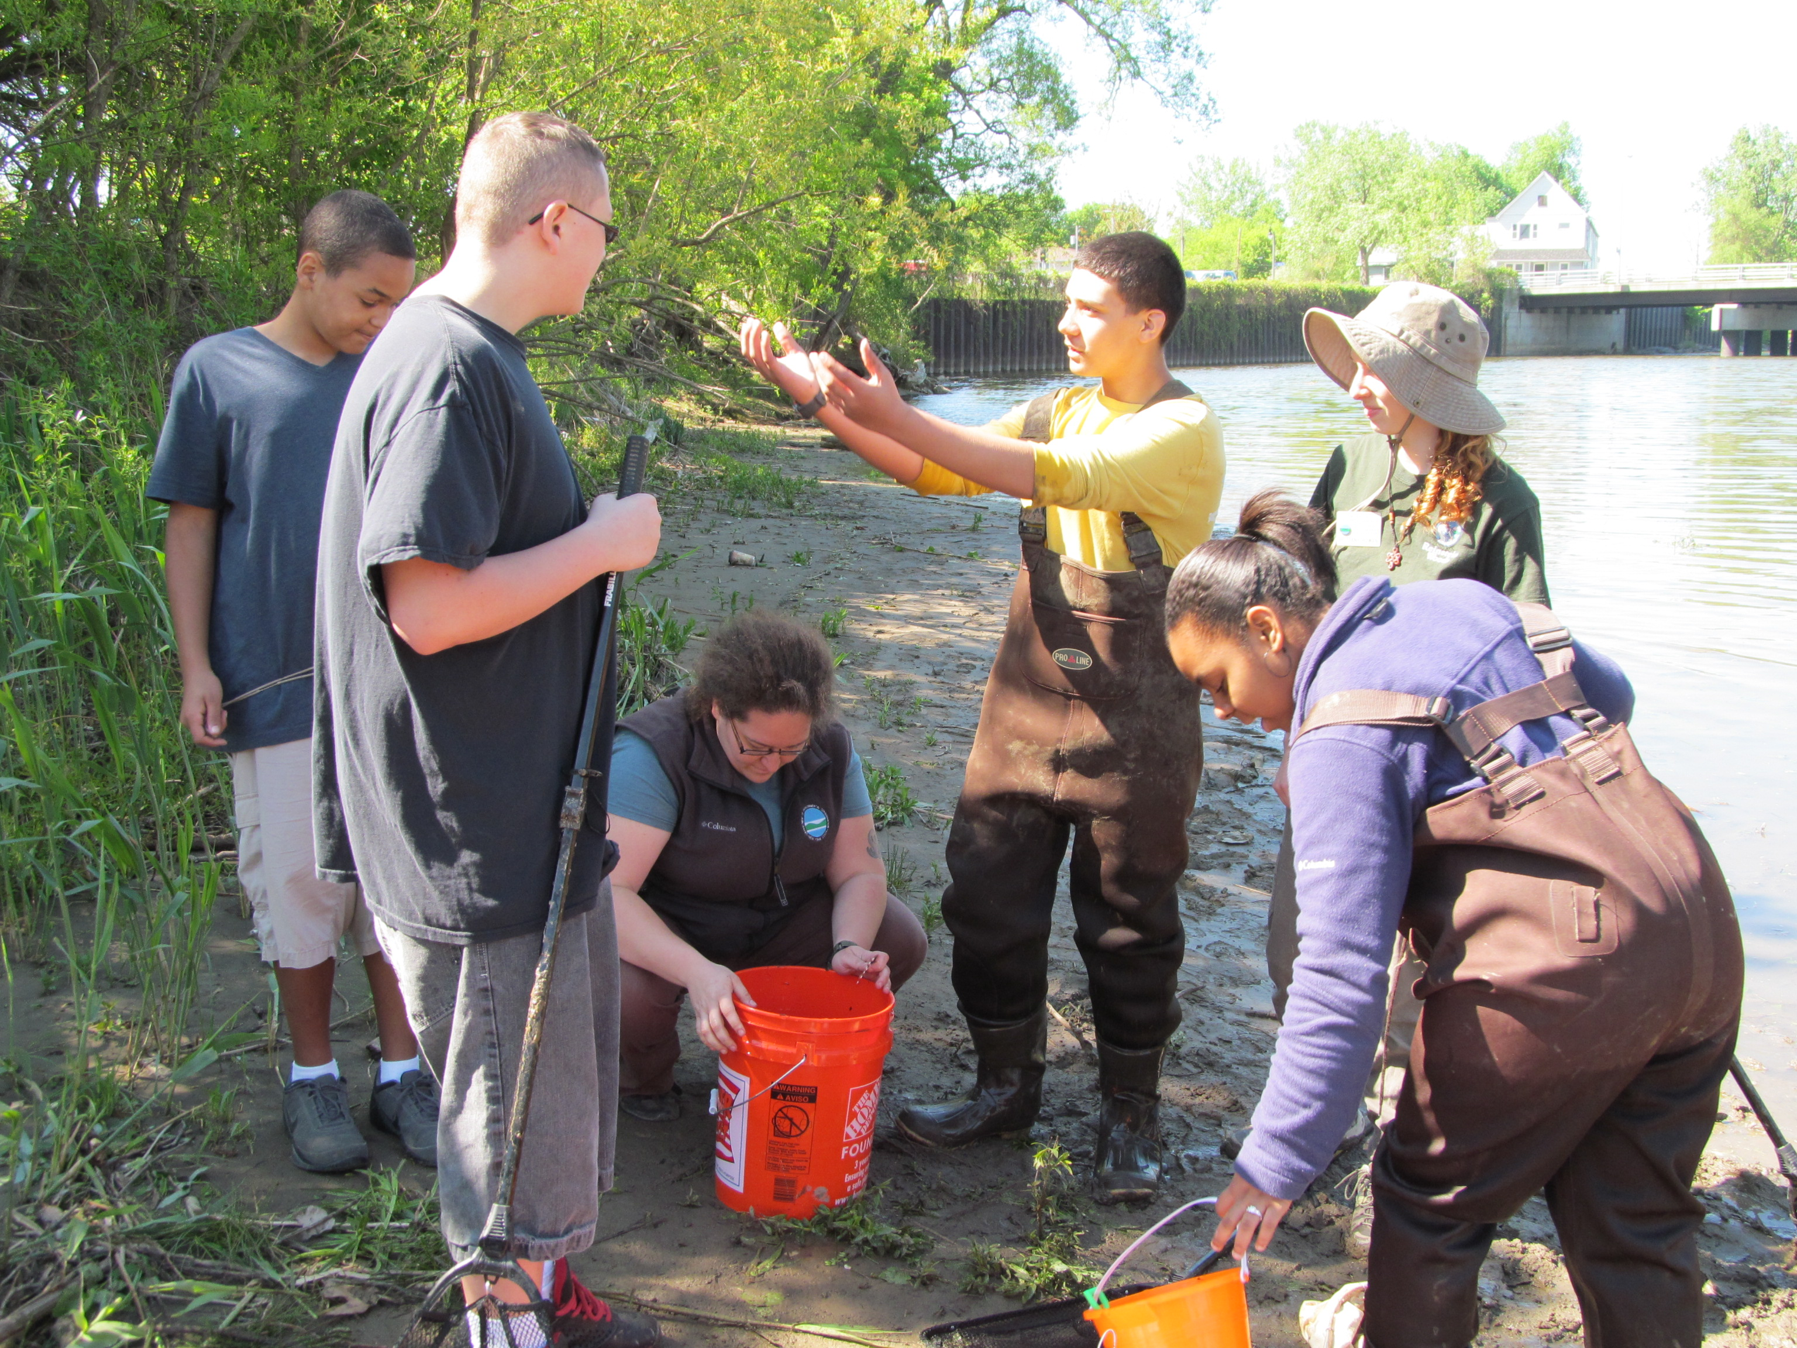
A Day in the Life of the Buffalo River Teacher Training

Slide 2
DITL Teacher Materials
These documents are all available for download online at:
www.reinsteinwoods.org/dayinthelife/teachers
You may wish to reference these documents during this training.
Important teacher materials:
Teacher Information Packet: Event information, background and activity instructions.
Student Activity Packet: student worksheets for day of the event.
Master Datasheets: fill this out with all your data at end of event and send to Reinstein Woods.
Sample Site Description/Map: your school’s unique site where you will sample during the event.
Model Release: permission to take pictures of students during the event. Must be signed by parent/guardian.
Supplemental materials:
Includes maps of the rivers and samples sites, fish and macroinvertebrate (bug) identification, history of the Buffalo River, etc. Reinstein Woods will bring these materials to the event.

Slide 3
What is “A Day in the Life”?
“A Day in the Life” is all about hands-on discovery!
Each school is assigned to a “sample site” along the Buffalo River or its tributaries. Students collect and record data to create a “snapshot” of the river’s current conditions.
Data is then shared on the Web so participants can see how their site fits into the entire Buffalo River watershed.
There are four main parts of the Buffalo River event:
The Historical River: how the river’s past influences its present.
The Physical River: temperature, weather, wind and environment at the site.
The Zoological River: collect and identify animals to determine water quality.
The Chemical River: measure pH and dissolved oxygen levels.
Notes:
A watershed is an area of land where all living things and linked by a common water source.

Slide 4
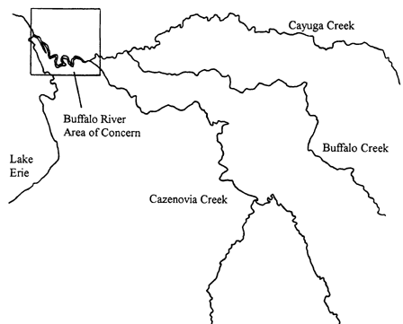
The Buffalo River
The Buffalo River flows into Lake Erie. Three tributaries join together to form the Buffalo River:
Cayuga Creek, Buffalo Creek, and Cazenovia Creek.
Buffalo River
Notes:
3 tributaries: Cayuga, Buffalo, Cazenovia
Join together at various points to form Buffalo River (8.7 miles long)

Slide 5
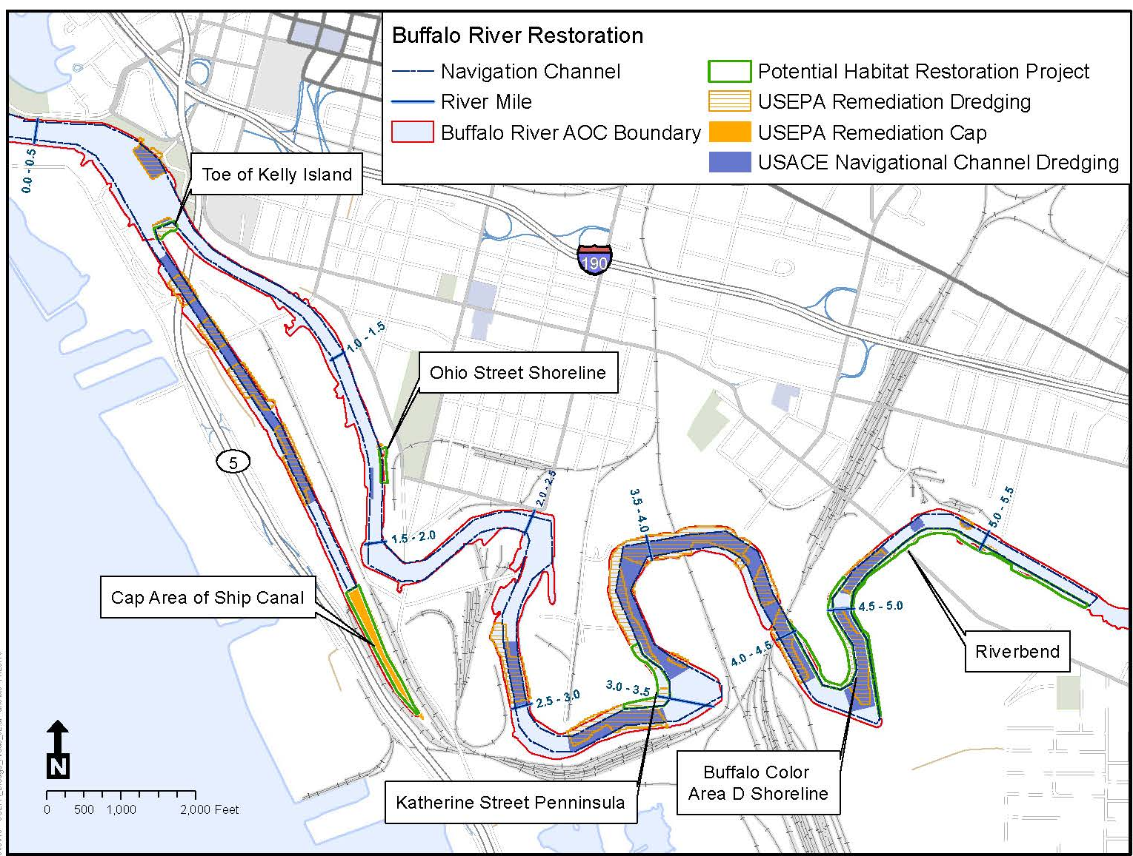
Brief History
1900s: Buffalo experiences huge industrial and economic growth along the waterfront. Industries dump toxic chemicals into the river.
1965: Buffalo River declared functionally dead and “devoid of life.”
1987: Buffalo River named an “Area of Concern” by the Environmental Protection Agency due to its severe environmental degradation.
2011: The Buffalo River Restoration Partnership begins major restoration efforts.
2019: The Buffalo River is no longer an Area of Concern (???)
Area of Concern/Buffalo River Restoration
Map: Ecology & Environment
Notes:
Please see “Buffalo River Watershed/Historic Industries/River & Tributaries, “DITLBR Sample Sites”
“Event Overview – Historical Timeline/10 Cool Facts” for more information.
Also, Teacher Packet: “A Brief Look at the Buffalo River.”

Slide 6
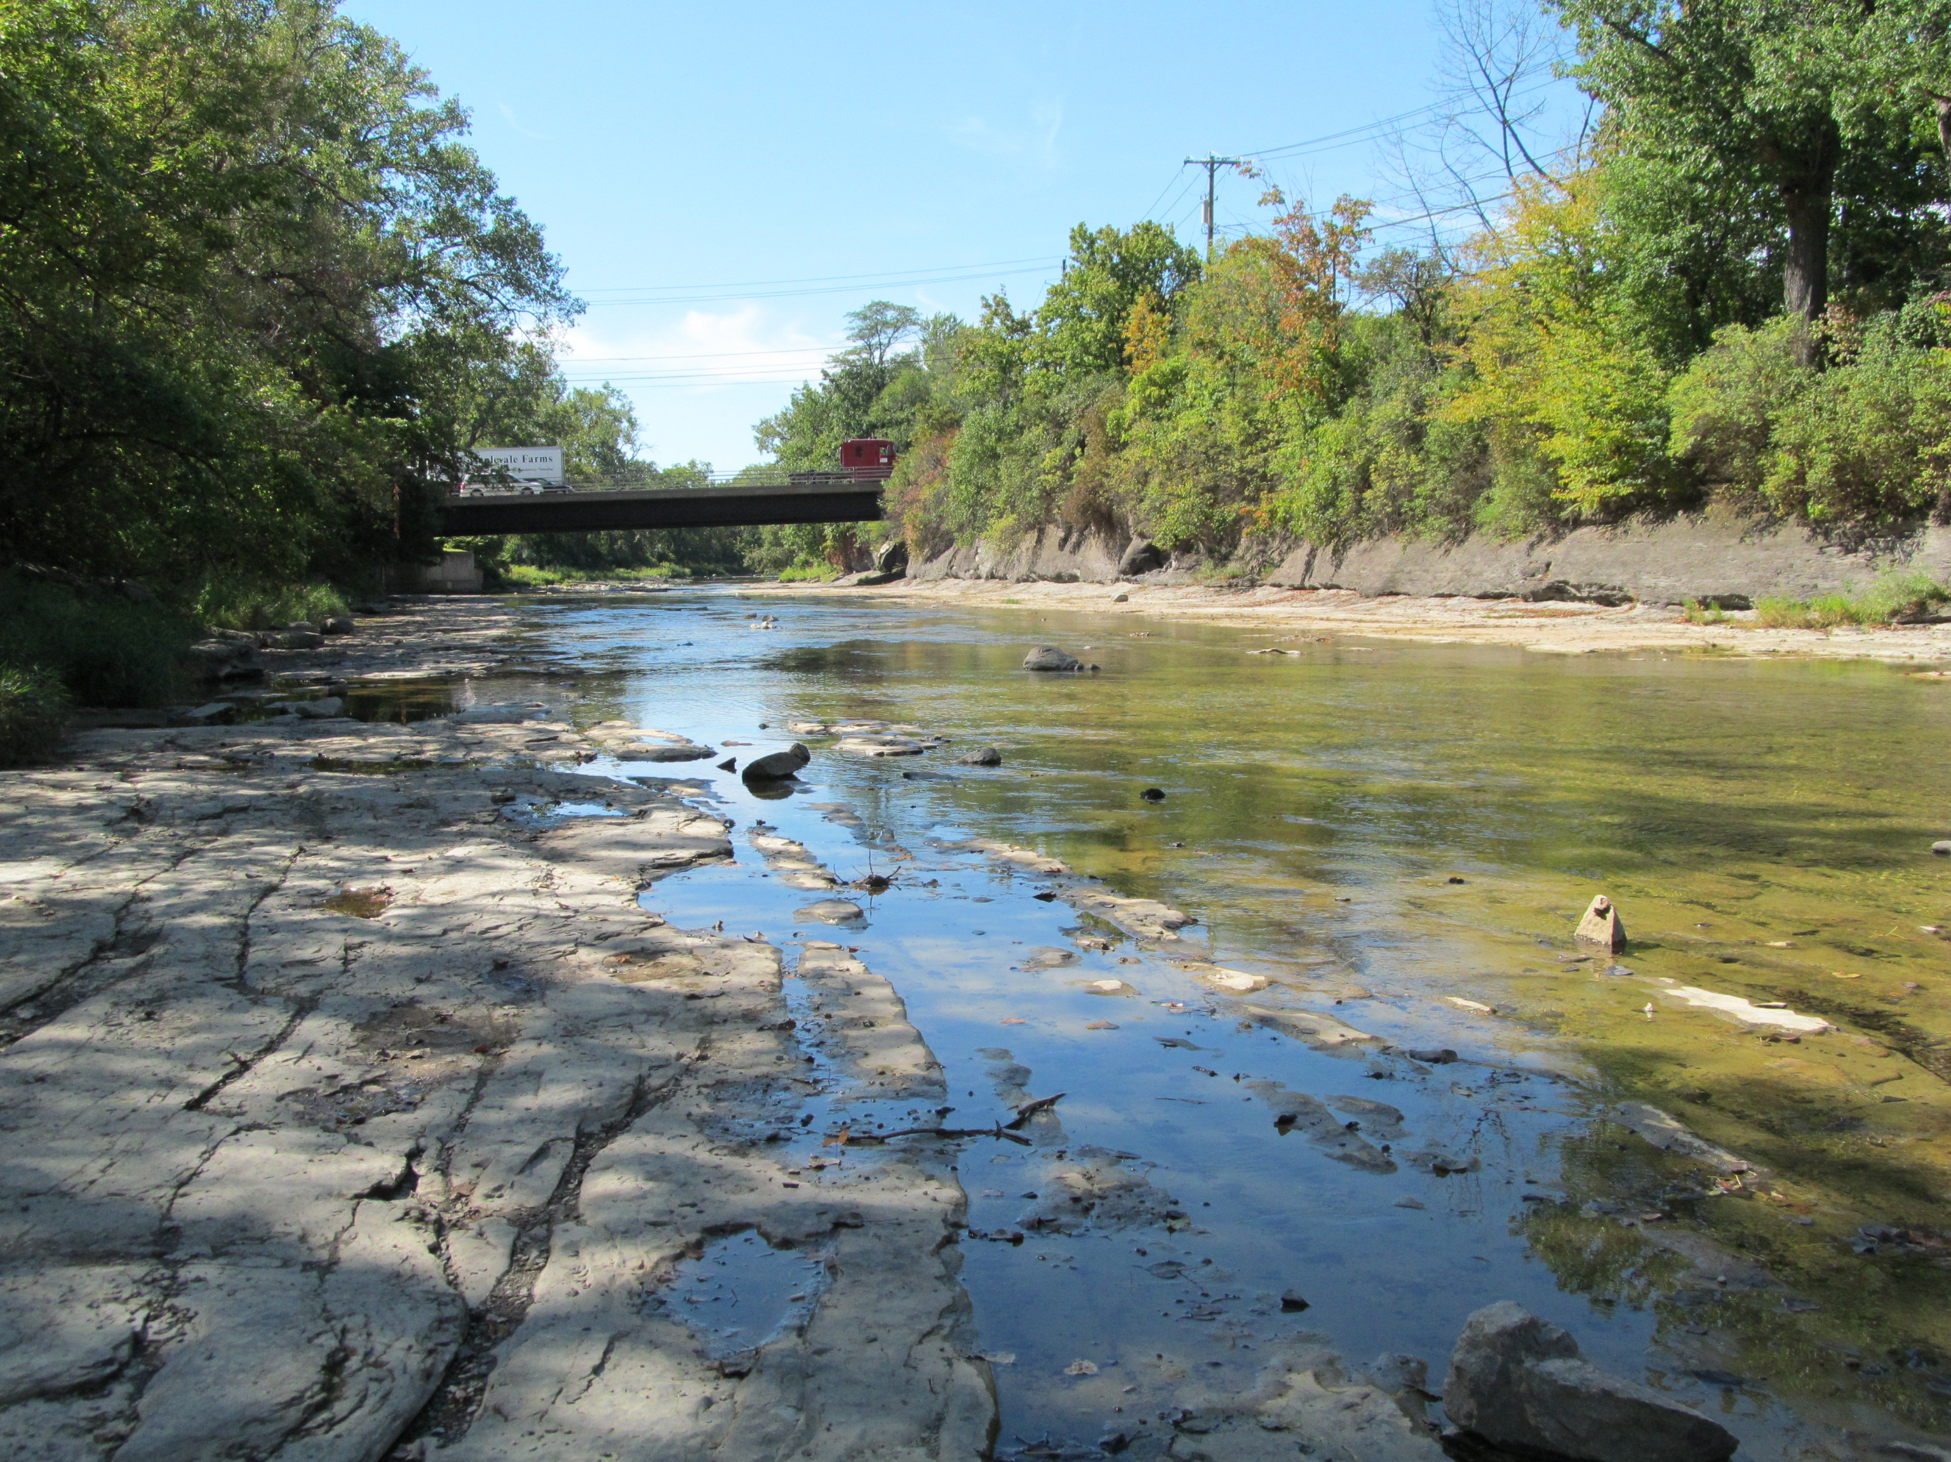
Sample Site
You may download your site description and map at:
reinsteinwoods.org/dayinthelife/samplesites
Each site is unique, and ranges from city parks to rural nature preserves.
Packet gives address (or closest address/latitude & longitude) of your school’s sample site.
Note: Individual school-to-site directions are not included. The directions in the packets are for event partner and volunteer use.
Packet provides pictures and description of sample site.
Map provides directions to nearest restroom facilities (may be on-site or a nearby gas station).
Note: restroom facilities may be limited at your site. Ensure students are aware of this.
Sample sites were chosen based on safety, accessibility, and landowner permission.
Schools were assigned to sample site based on class size, size of sample site, and proximity of site to school.

Slide 7
Before the Event Teacher Packet – Event Information, page 1
Student Preparation Powerpoint available online.
Make copies of Student Activity Packet to be used on day of event.
Transportation: teacher is responsible for arranging a bus. Send bus invoice to Reinstein Woods before December 31. Reinstein will apply bus grant money; the rest must be covered by school.
Equipment: All essential equipment is provided by Reinstein Woods. Teacher may bring extra equipment (see “Suggested Equipment” list on page 3).
Inform Reinstein Woods of any student special needs or other concerns at least 2 weeks PRIOR to the event.
Invite extra chaperones to the event – teacher aids/other teachers are welcome (strongly encouraged).
Optional:
Model Releases: make copies and send home to be signed by parents. Return signed waivers to Reinstein Woods. This allows us to take and use pictures of the event.
Predictions Worksheet: see Teacher Packet, page 9

Slide 8
Event Information Teacher Packet page 1
Warning: students are guaranteed to get wet and muddy!
Dress appropriately.
Bring extra shoes or rubber boots.
Wear clothes that can get muddy.
Program should last between 2-3 hours.
At least one trained staff, partner, or volunteer will assist with the event at your site.
7 activities; 15 minutes per activity (more on activities later). Students rotate in small groups through all activities.
Lunch break: up to teacher to decide if & when to take a lunch during event.
Please return all equipment to staff person at the end of the event.
Please ensure the site and its facilities are left in good order (no garbage, etc.)

Slide 9
Staff, Volunteers & Partner Organizations
Each school is partnered with a local organization.
Staff, Partners, and Volunteers:
1-3 people per site
Will meet your class at the sample site.
Will bring essential equipment to site.
Will assist with activities: handing out equipment, understanding directions, interpreting data, etc.
May bring their own equipment for additional testing with students.

Slide 10
Running the Event
Teachers MUST take an active role in running the program.
7 activities; 15 minutes per activity
Each activity has a laminated Instructions sheet (except #4).
Each activity will have a station marked with a flag/cone.
Break students up into no more than 7 groups of 3-6 students. Groups rotate through activities in order.
Equipment mostly organized in bags marked with activity number. Some equipment is used in multiple activities.
Please discuss any issues that arise with your site leader.
Safety:
The teacher is responsible for student safety and emergencies.
1-2 Life jacket(s) and waders are provided. Shallow wading is permissible, but no swimming or deep wading is allowed.
Event may be cancelled in the event of severe weather.
Notes:
Many activities self-explanatory, some may require assistance.
“Field Observation” boxes encourage students to think about their results.

Slide 11
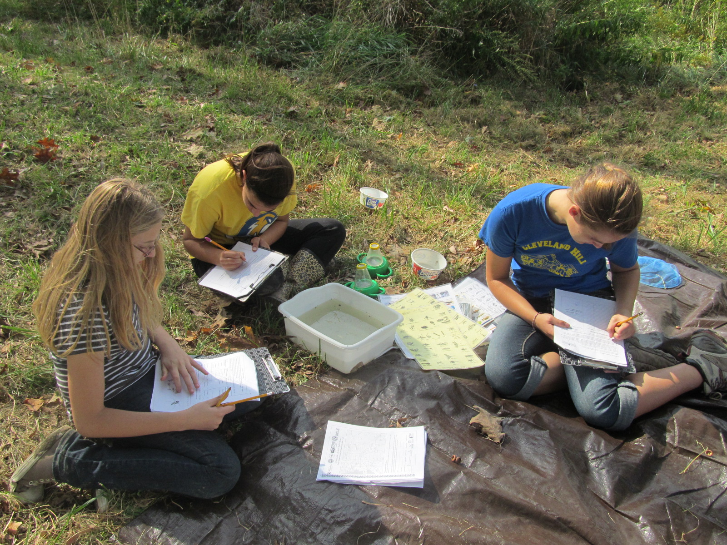
After the Event
Complete the Master Datasheets and feedback and send to Reinstein Woods by November 30 of your participating year.
Optional: complete your Predictions Worksheet and compare your actual results with your predicted results!
Bus invoice: send to Reinstein Woods, Attn Office Manager by December 31 of your participating year.
Check out the results on the website in winter!
Upon successful completion of the Program (see Teacher Packet, page 2, “Educator Contract”), you will receive your $25 deposit back plus a $25 stipend.
reinsteinwoods.org/dayinthelife/data

Slide 12
The Activities
The activities are meant to appeal to a wide range of students (grades 3-12). Some activities have “extra”, more advanced components that may be above your grade level. You are free to modify the activities to be relevant and appropriate for your class.
The activities are outlined in your teacher packet, complete with background information and vocabulary words.
You may also refer to the Activity Instructions document for full instructions.

Slide 13
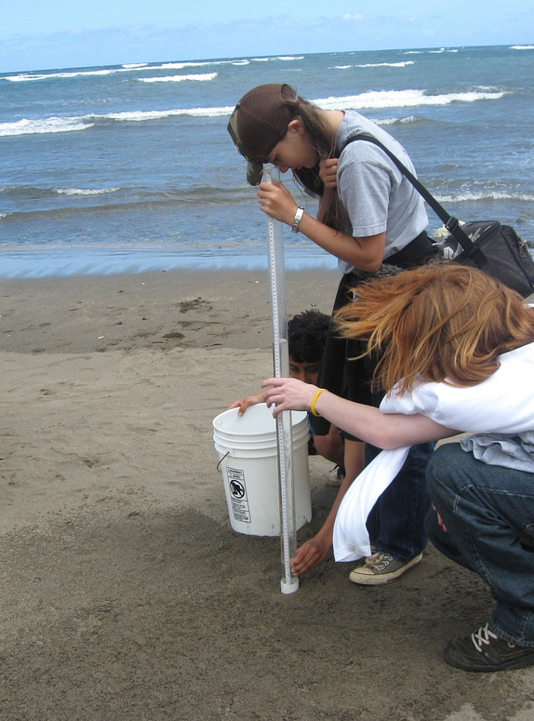
#1: Turbidity
How turbid is the water?
Equipment: turbidity tube, measuring cup, waders, life jacket
Students use a turbidity tube and secchi disk to measure the cloudiness (turbidity) of the water.
Students visually assess the river and determine possible causes for it’s appearance.
Turbidity is caused by small plants, animals, sand, mud, and pollutants suspended in the water.
High turbidity levels can decrease dissolved oxygen and photosynthesis.

Slide 14
#2: Weather & Wind
How do weather and wind affect water quality?
Equipment:
Air thermometer
Compass
Students measure air temperature, observe current weather conditions, and determine how recent weather conditions could affect their data.
High winds increase dissolved oxygen.
Heavy rains might flush pollutants into the river.

Slide 15
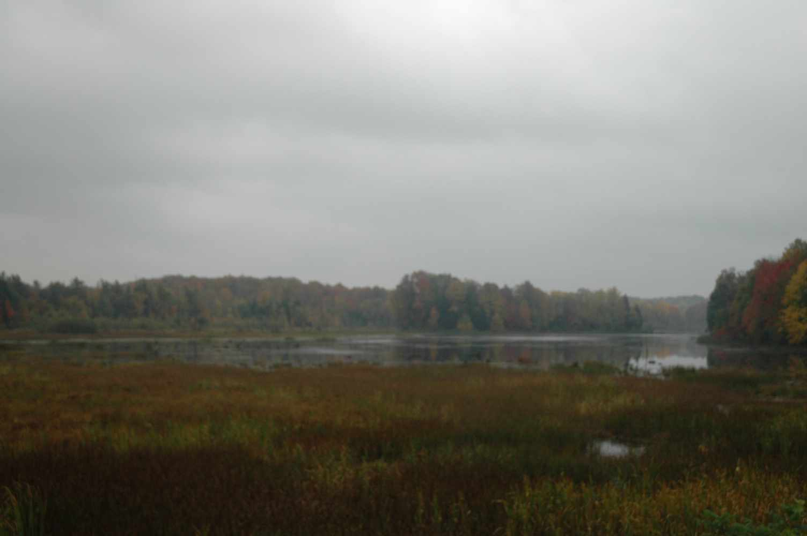
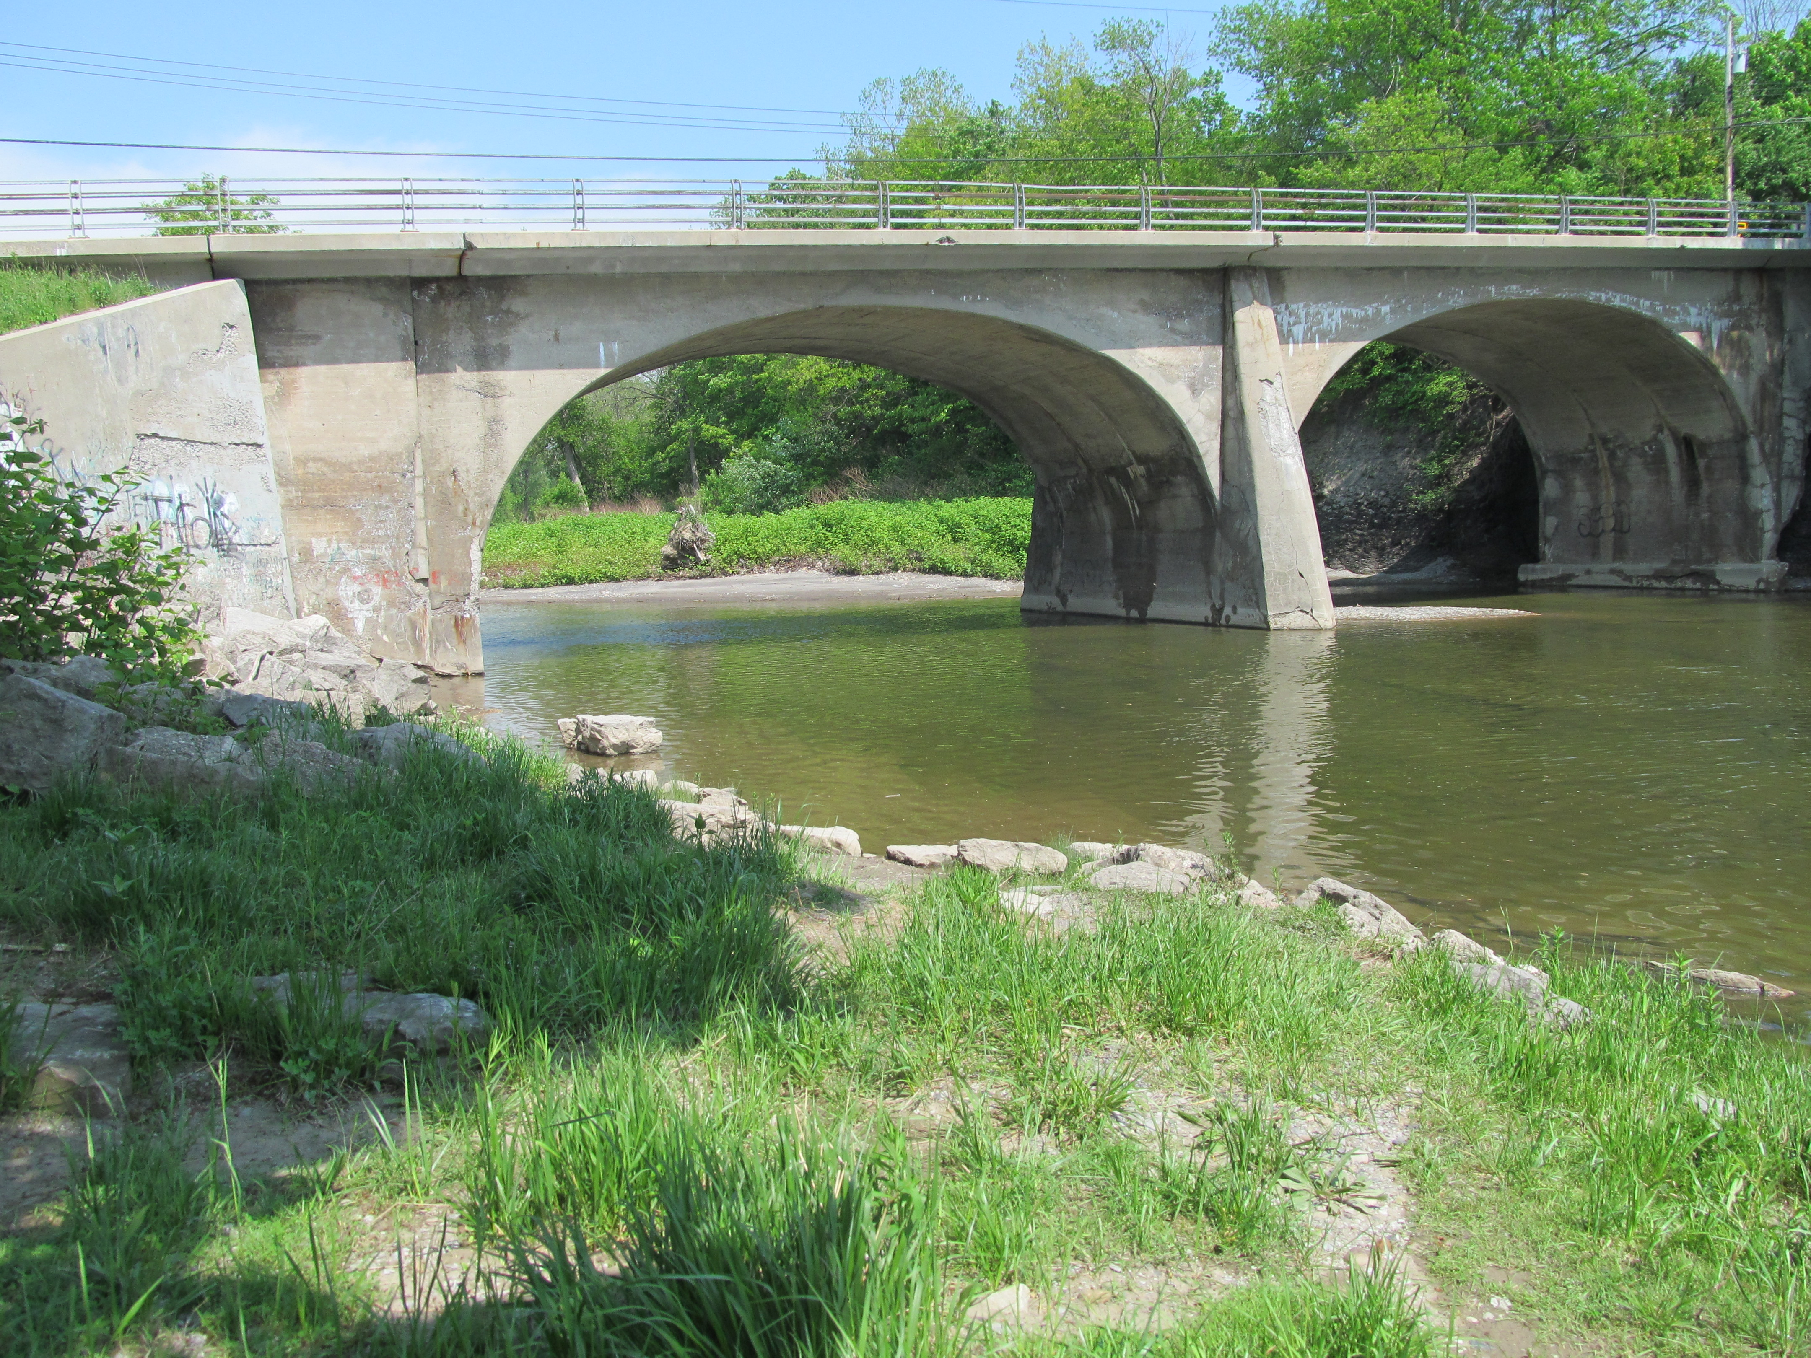
#3: Environment at the Sampling Site
How is each sample site unique?
Equipment: Measuring tape/stick, Waders, Life jacket, Field guides (optional)
Students investigate and describe the make-up of the surrounding environment and how the land use potentially affects the river.

Slide 16
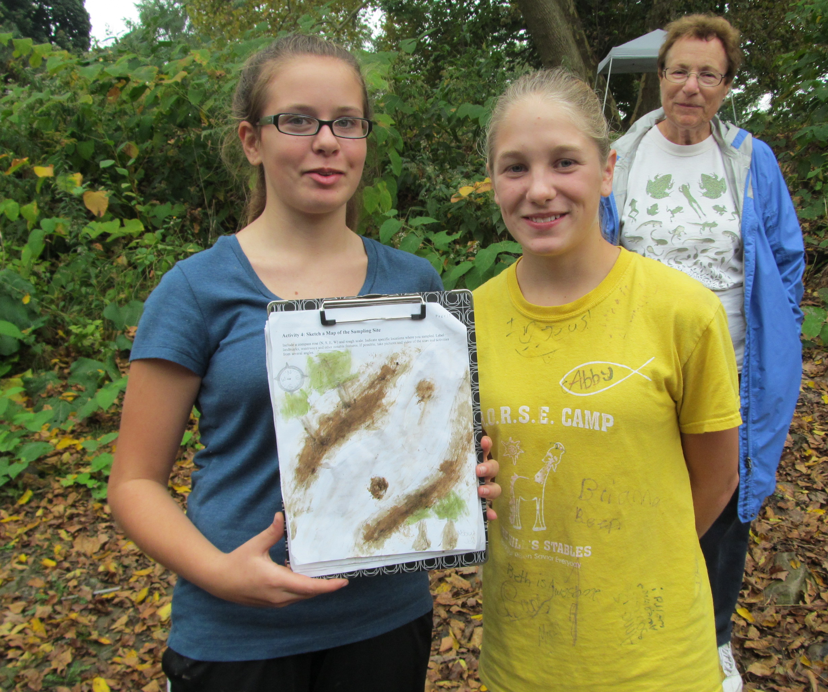
#4: Sketch a Map
What are the features and landmarks of the sample site?
Equipment: Colored pencils
Students explore and draw a map of the site, sampling locations, and major landmarks.
Note: There is no Datasheet or laminated Instruction Sheet for this activity.

Slide 17
#5: Water Temperature
What temperature is the water? How does temperature affect water quality?
Equipment: Water Thermometer, meter stick, waders
Students measure water temperature, record depth of sampling, and identify sources of thermal pollution at the site.
Cold water holds more oxygen than warm water.
Water temperature can affect feeding, spawning, and migration of fish.
Water temperature can change when heated water is dumped into the river (thermal pollution) or due to extreme temperature changes (weather).

Slide 18
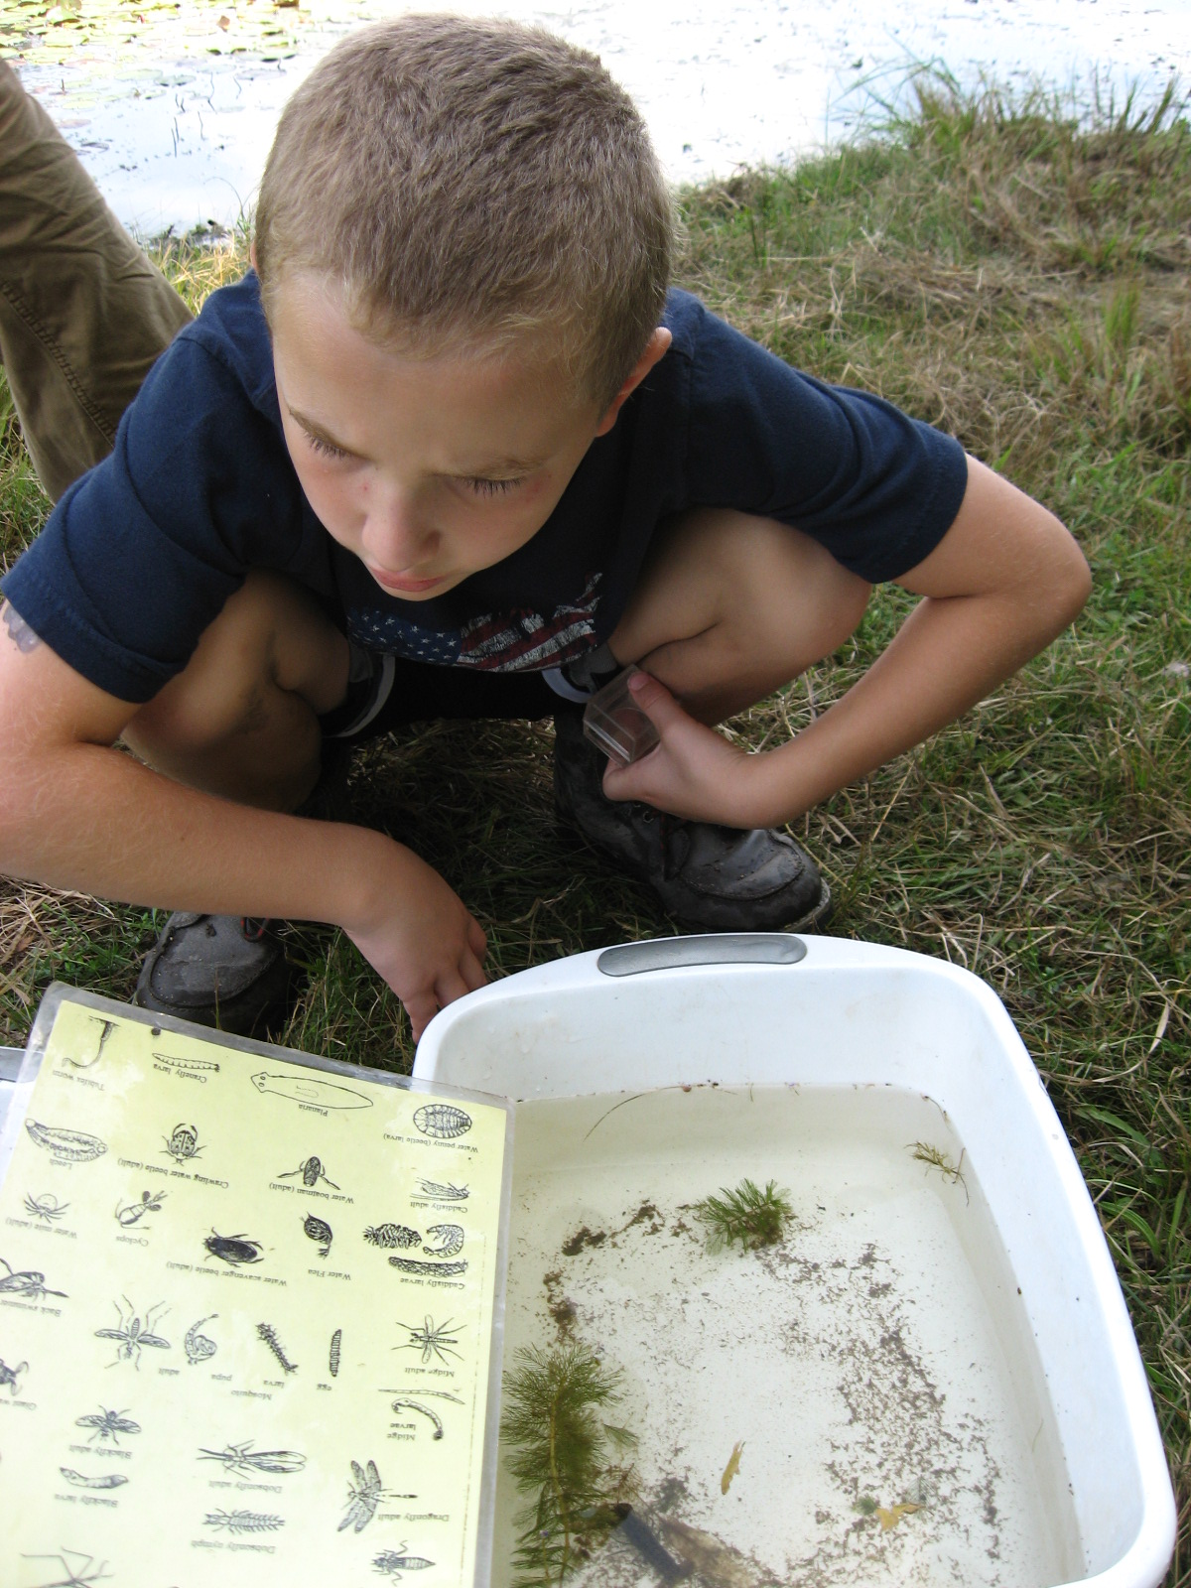
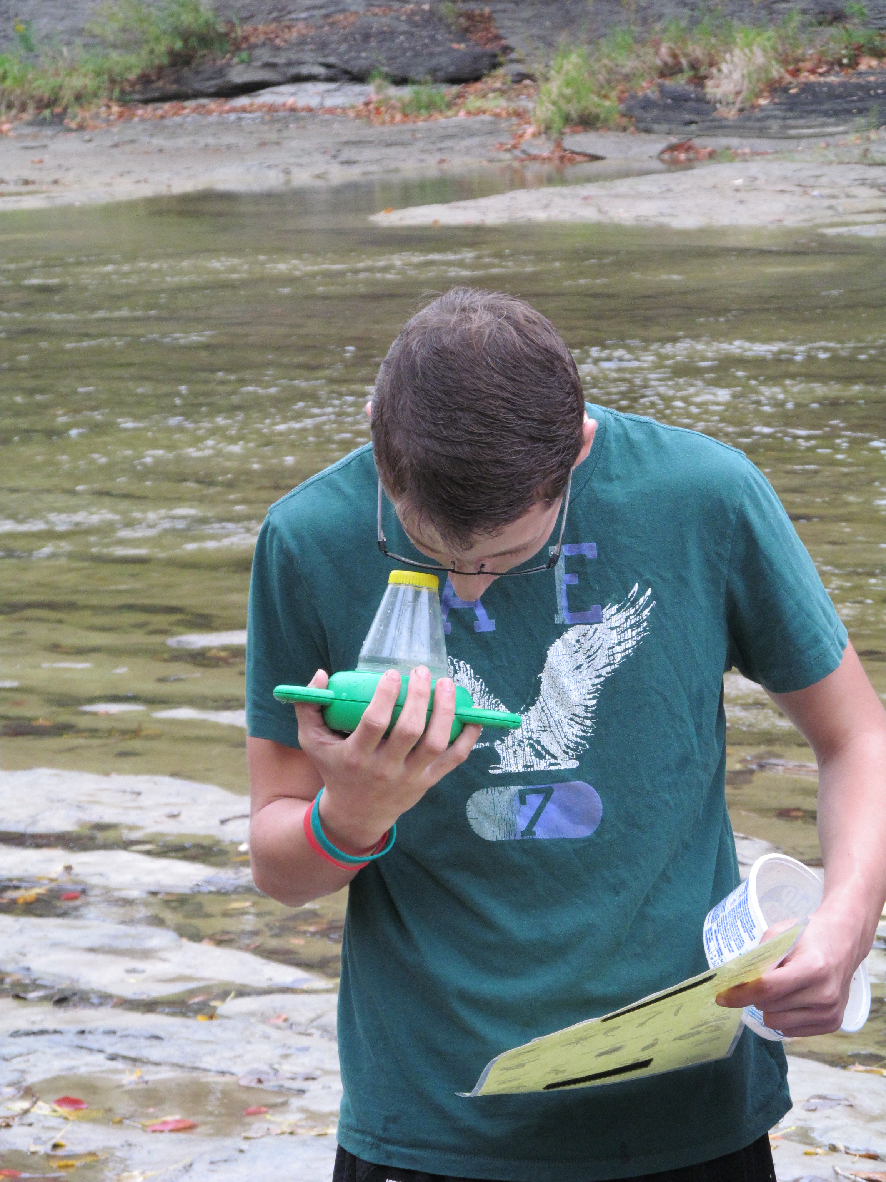
#6: Bioassessment
What lives in the river, and what can that tell us about water quality?
Equipment: Waders, life jacket, scoop nets, viewers, containers, shallow tubs, macroinvertebrate ID sheet, seine net
Students scoop for macroinvertebrates/aquatic animals, identify and record each species, and score their water quality based on their results.
Pollution Tolerance Index
Students complete a bioassessment, an inventory of living things that helps determine water quality.
Pollution tolerant vs. intolerant species: some macroinvertebrates are more sensitive to pollution than others.

Slide 19
#7: Water Chemistry - Dissolved Oxygen (DO)
How much oxygen is in the water?
Equipment: Water chemistry kit, waders, water thermometer, container for waste chemicals
Students measure DO levels by dissolving tablets in a water sample and matching the sample color to the DO chart.
Optional advanced activity: Determine percent (%) saturation – to what degree the water is saturated with oxygen.
A healthy stream DO range is 5 – 11 ppm.
Photosynthesis and windy conditions ADD oxygen to water.
Decomposition, respiration, and pollution SUBTRACT oxygen from water.

Slide 20
#7: Water Chemistry - pH
How acidic or basic is the water? Is it suitable for life?
Equipment: Water chemistry kit, waders, container for waste chemicals
pH Scale
Students measure pH levels by dissolving tablets or test strips in a water sample and matching the sample color to the pH chart.
A healthy stream pH range is 6.5 – 8.2.
Acid rain lowers pH (more acidic).
Many organisms are very sensitive to pH changes.

Slide 21
Time Fillers
“Field Observation” boxes in student packet have extra activities and encourage students to think about results.
Scoop for macroinvertebrates.
Have students share their data results.
Partners: can discuss their organization’s connection to the river and/or do additional testing.
Staff, Partners, and Volunteers: can discuss a variety of river-related topics.
Explore sample site/ID plants & animals.
“10 Cool Facts about the Buffalo River Watershed” sheet.
Notes:
Expertise: Great lakes Issues, invasive species, history, pollution, restoration efforts, flora & fauna, water chemistry, etc.

Slide 22
End of Event
Students help collect and clean equipment and return it to the bin.
Ensure sample site and its facilities are left in good order.
Have students share something they learned/a way to protect the river.
The tarp is a great place to collect equipment.

Slide 23
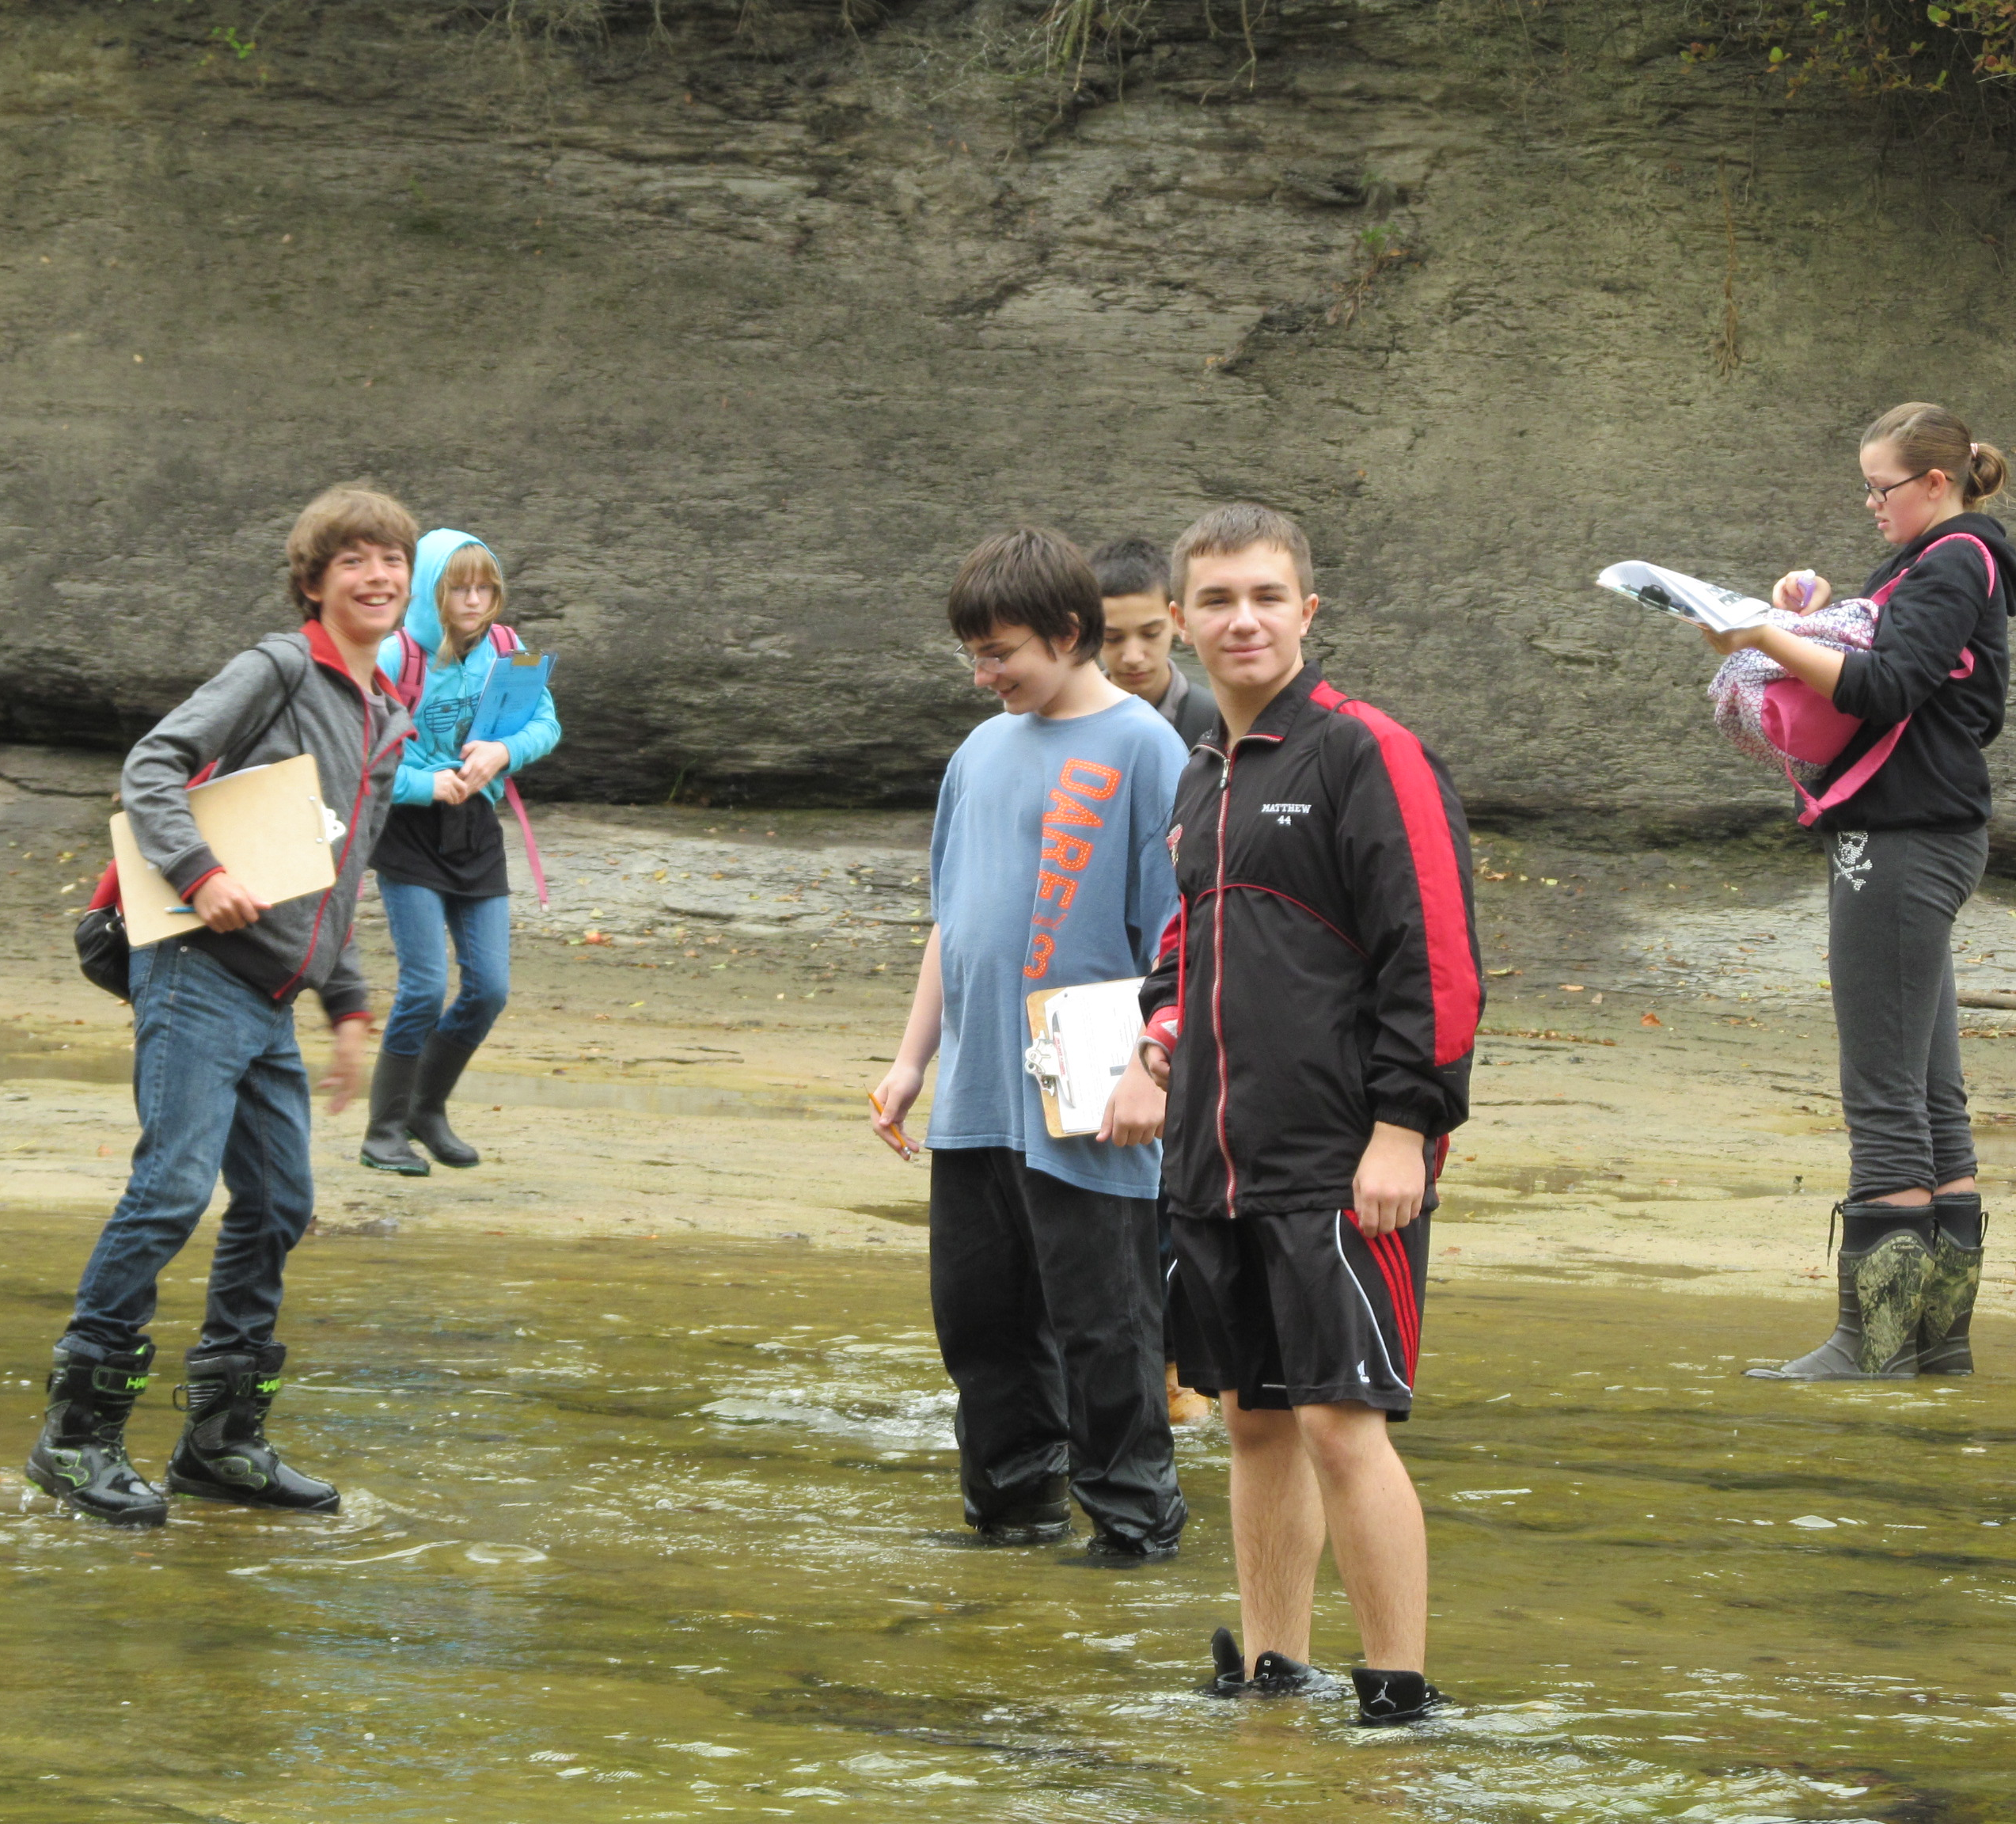
Contact Us/Links
You will receive a final event confirmation in September.
We look forward to seeing you on the Buffalo River!
Please direct questions/concerns to:
Brittany Rowan
brittany.rowan@dec.ny.gov
716-683-5959 x205
Reinstein Woods
93 Honorine Drive
Depew, NY 14043
A Day in the Life of the Buffalo River website:
www.reinsteinwoods.org/dayinthelife
Data website:
http://communityservice.buffalostate.edu/BuffaloRiver/index.html
Friends of Reinstein Woods
www.reinsteinwoods.org
Dept. of Enviornmental Conservation – Reinstein Woods
http://www.dec.ny.gov/education/1837.html

